Slide 1

M5 – Visual Recognition
Project: Cross-modal Retrieval
Week 4: Image Retrieval
​
Group 3: Guillem Capellera, Abel García, Johnny Nuñez and Anna Oliveras
Notes:
My name is
What?
My name is
Who?
My name is
Chika-chika
Slim Shady

Slide 2
Tasks
Week 4
a. Image retrieval with pre-trained image classification model.
b. Train the model on metric learning (Siamese network).
c. Train the model on metric learning (Triplet network).
d. Visualize the learned image representation of each of the previous tasks a-c
e. Image Retrieval on COCO with Faster R-CNN or Mask R-CNN
f. Finish the paper: Results and Conclusions.

Slide 3
Task a: Image retrieval with pre-trained image classification model.

Slide 4
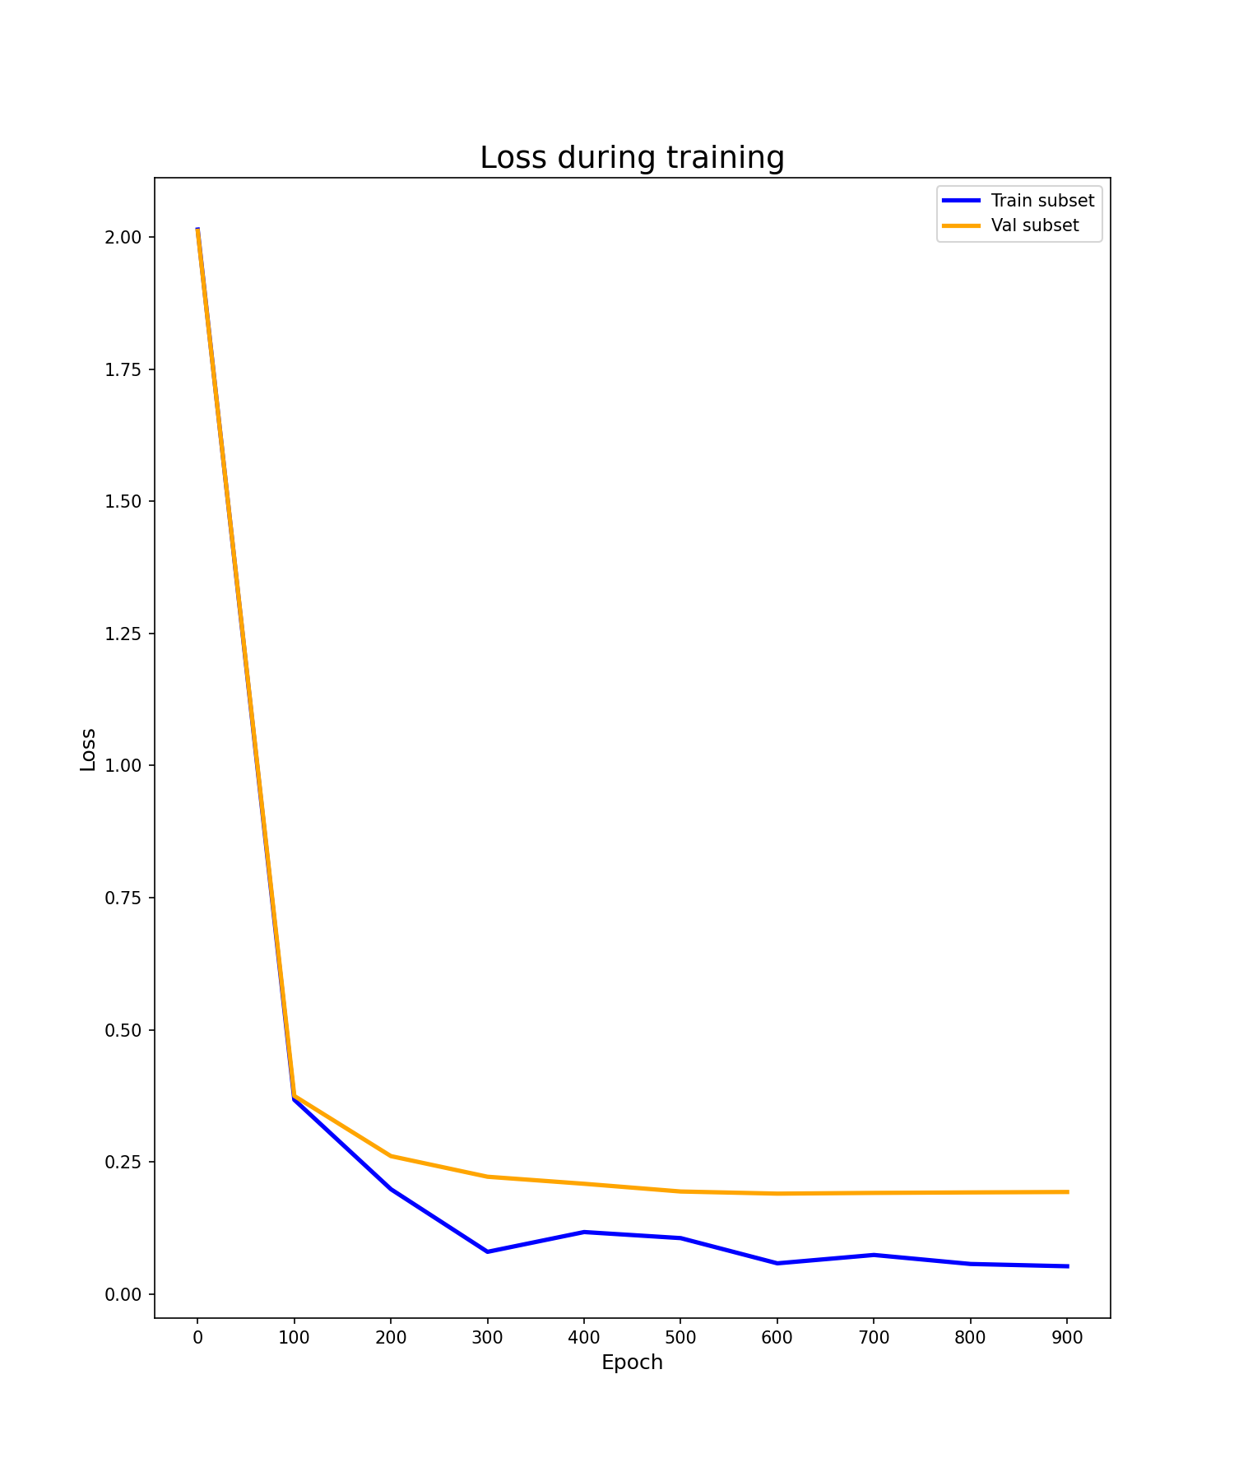
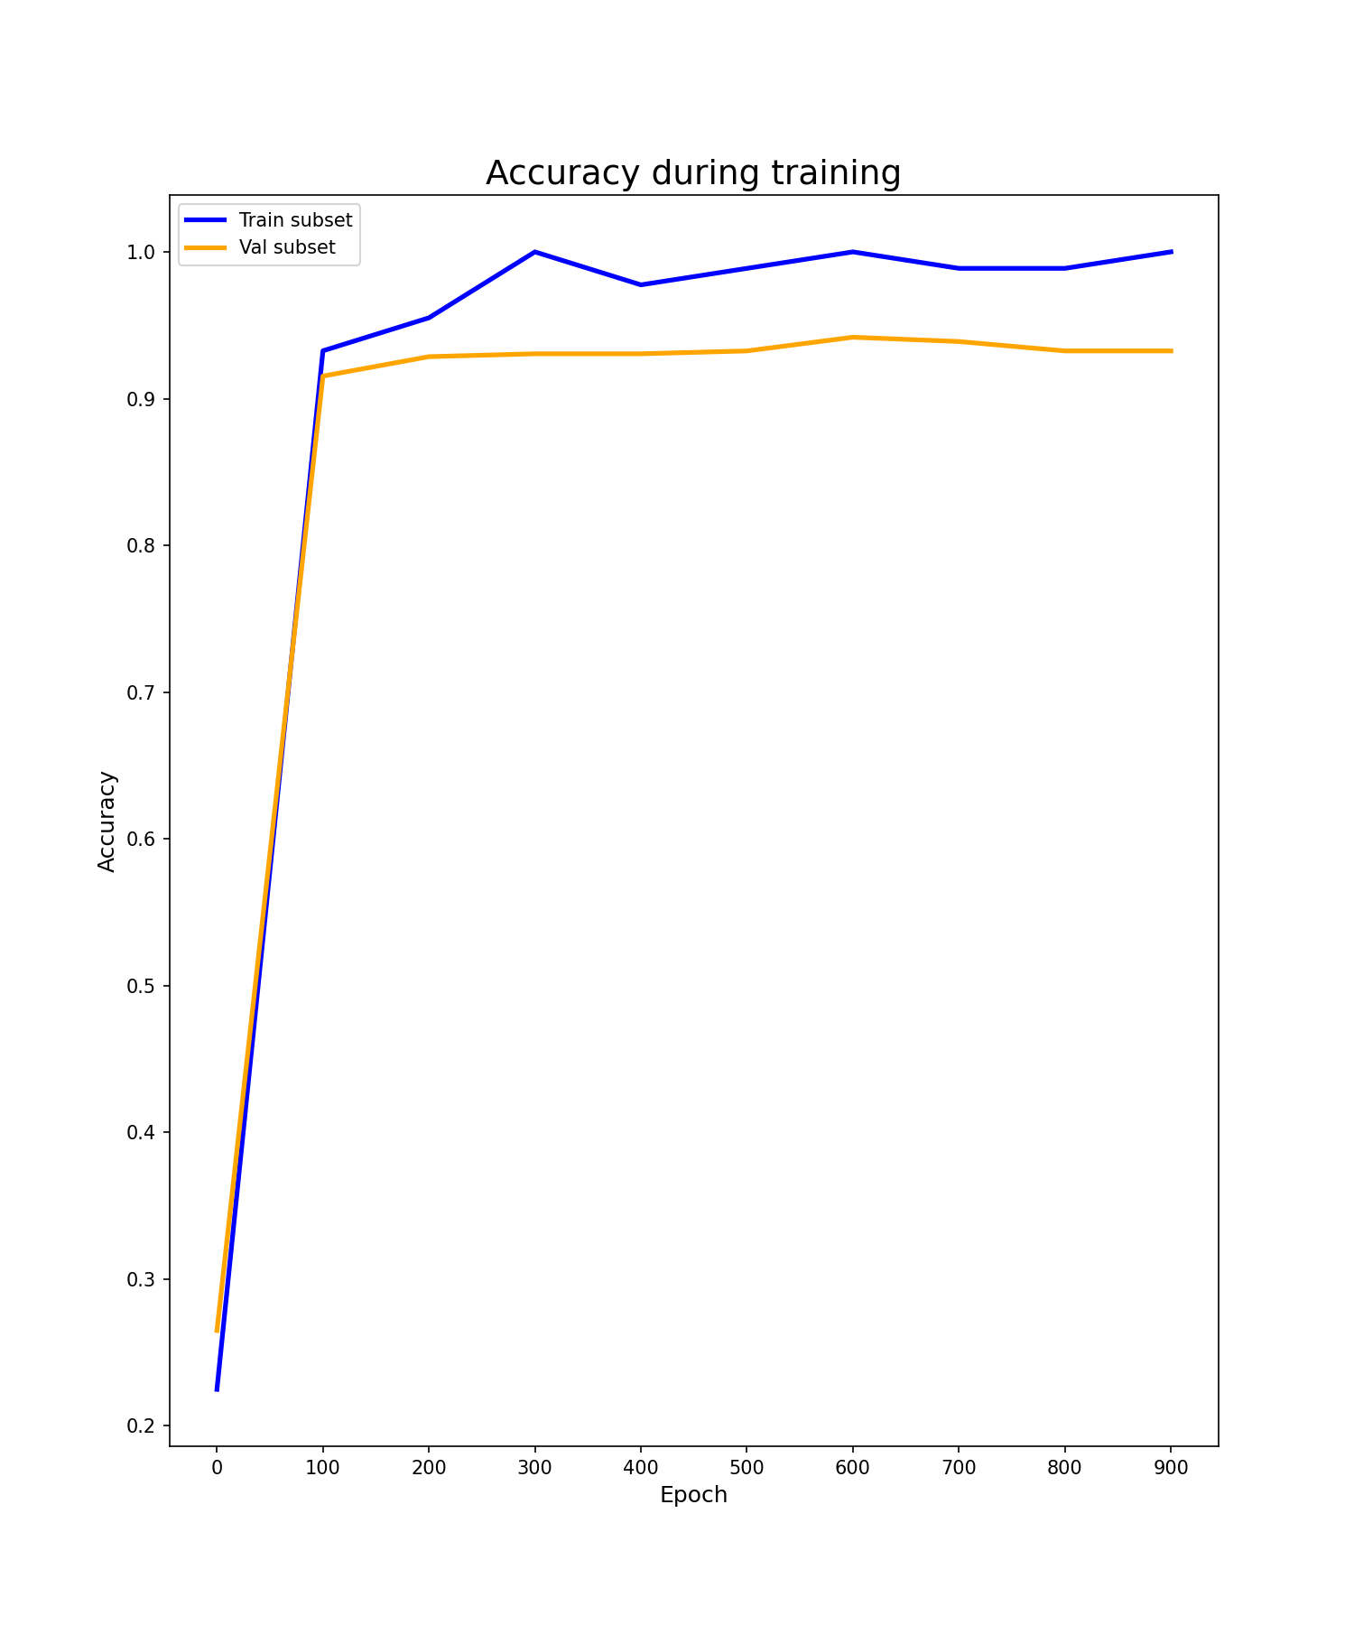
Task (a): Image retrieval with pre-trained image classification model
1. Load pre-trained Resnet50 model on ImageNet.
2. Fine-tune the model in our MIT_split dataset:
Both, the loss and the accuracy plot show that the model was correctly trained and there is no overfitting.
However, note that there were necessary a lot of epochs to converge.

Slide 5
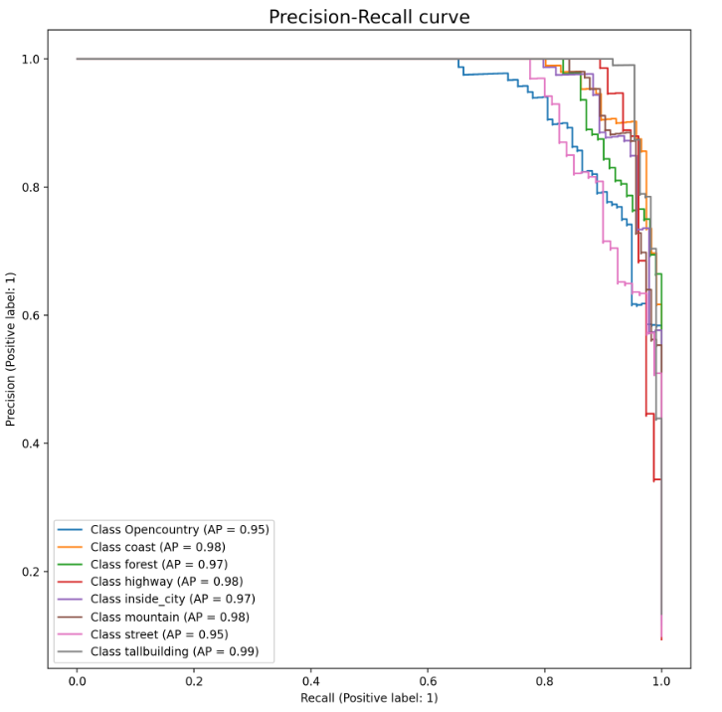
Task (a): Image retrieval with pre-trained image classification model
3. Evaluate classification metrics on validation and test subsets to check the model extracts useful features:
We can see that accuracy is extremely high even
for test subset.
Also, Precision-Recall curve is almost perfect.
This is due to the fact that there are just 8 classes
after fine-tuning, and also because images are
small and simple.
Subset | Accuracy
Train | 0.9775
Test | 0.9360

Slide 6
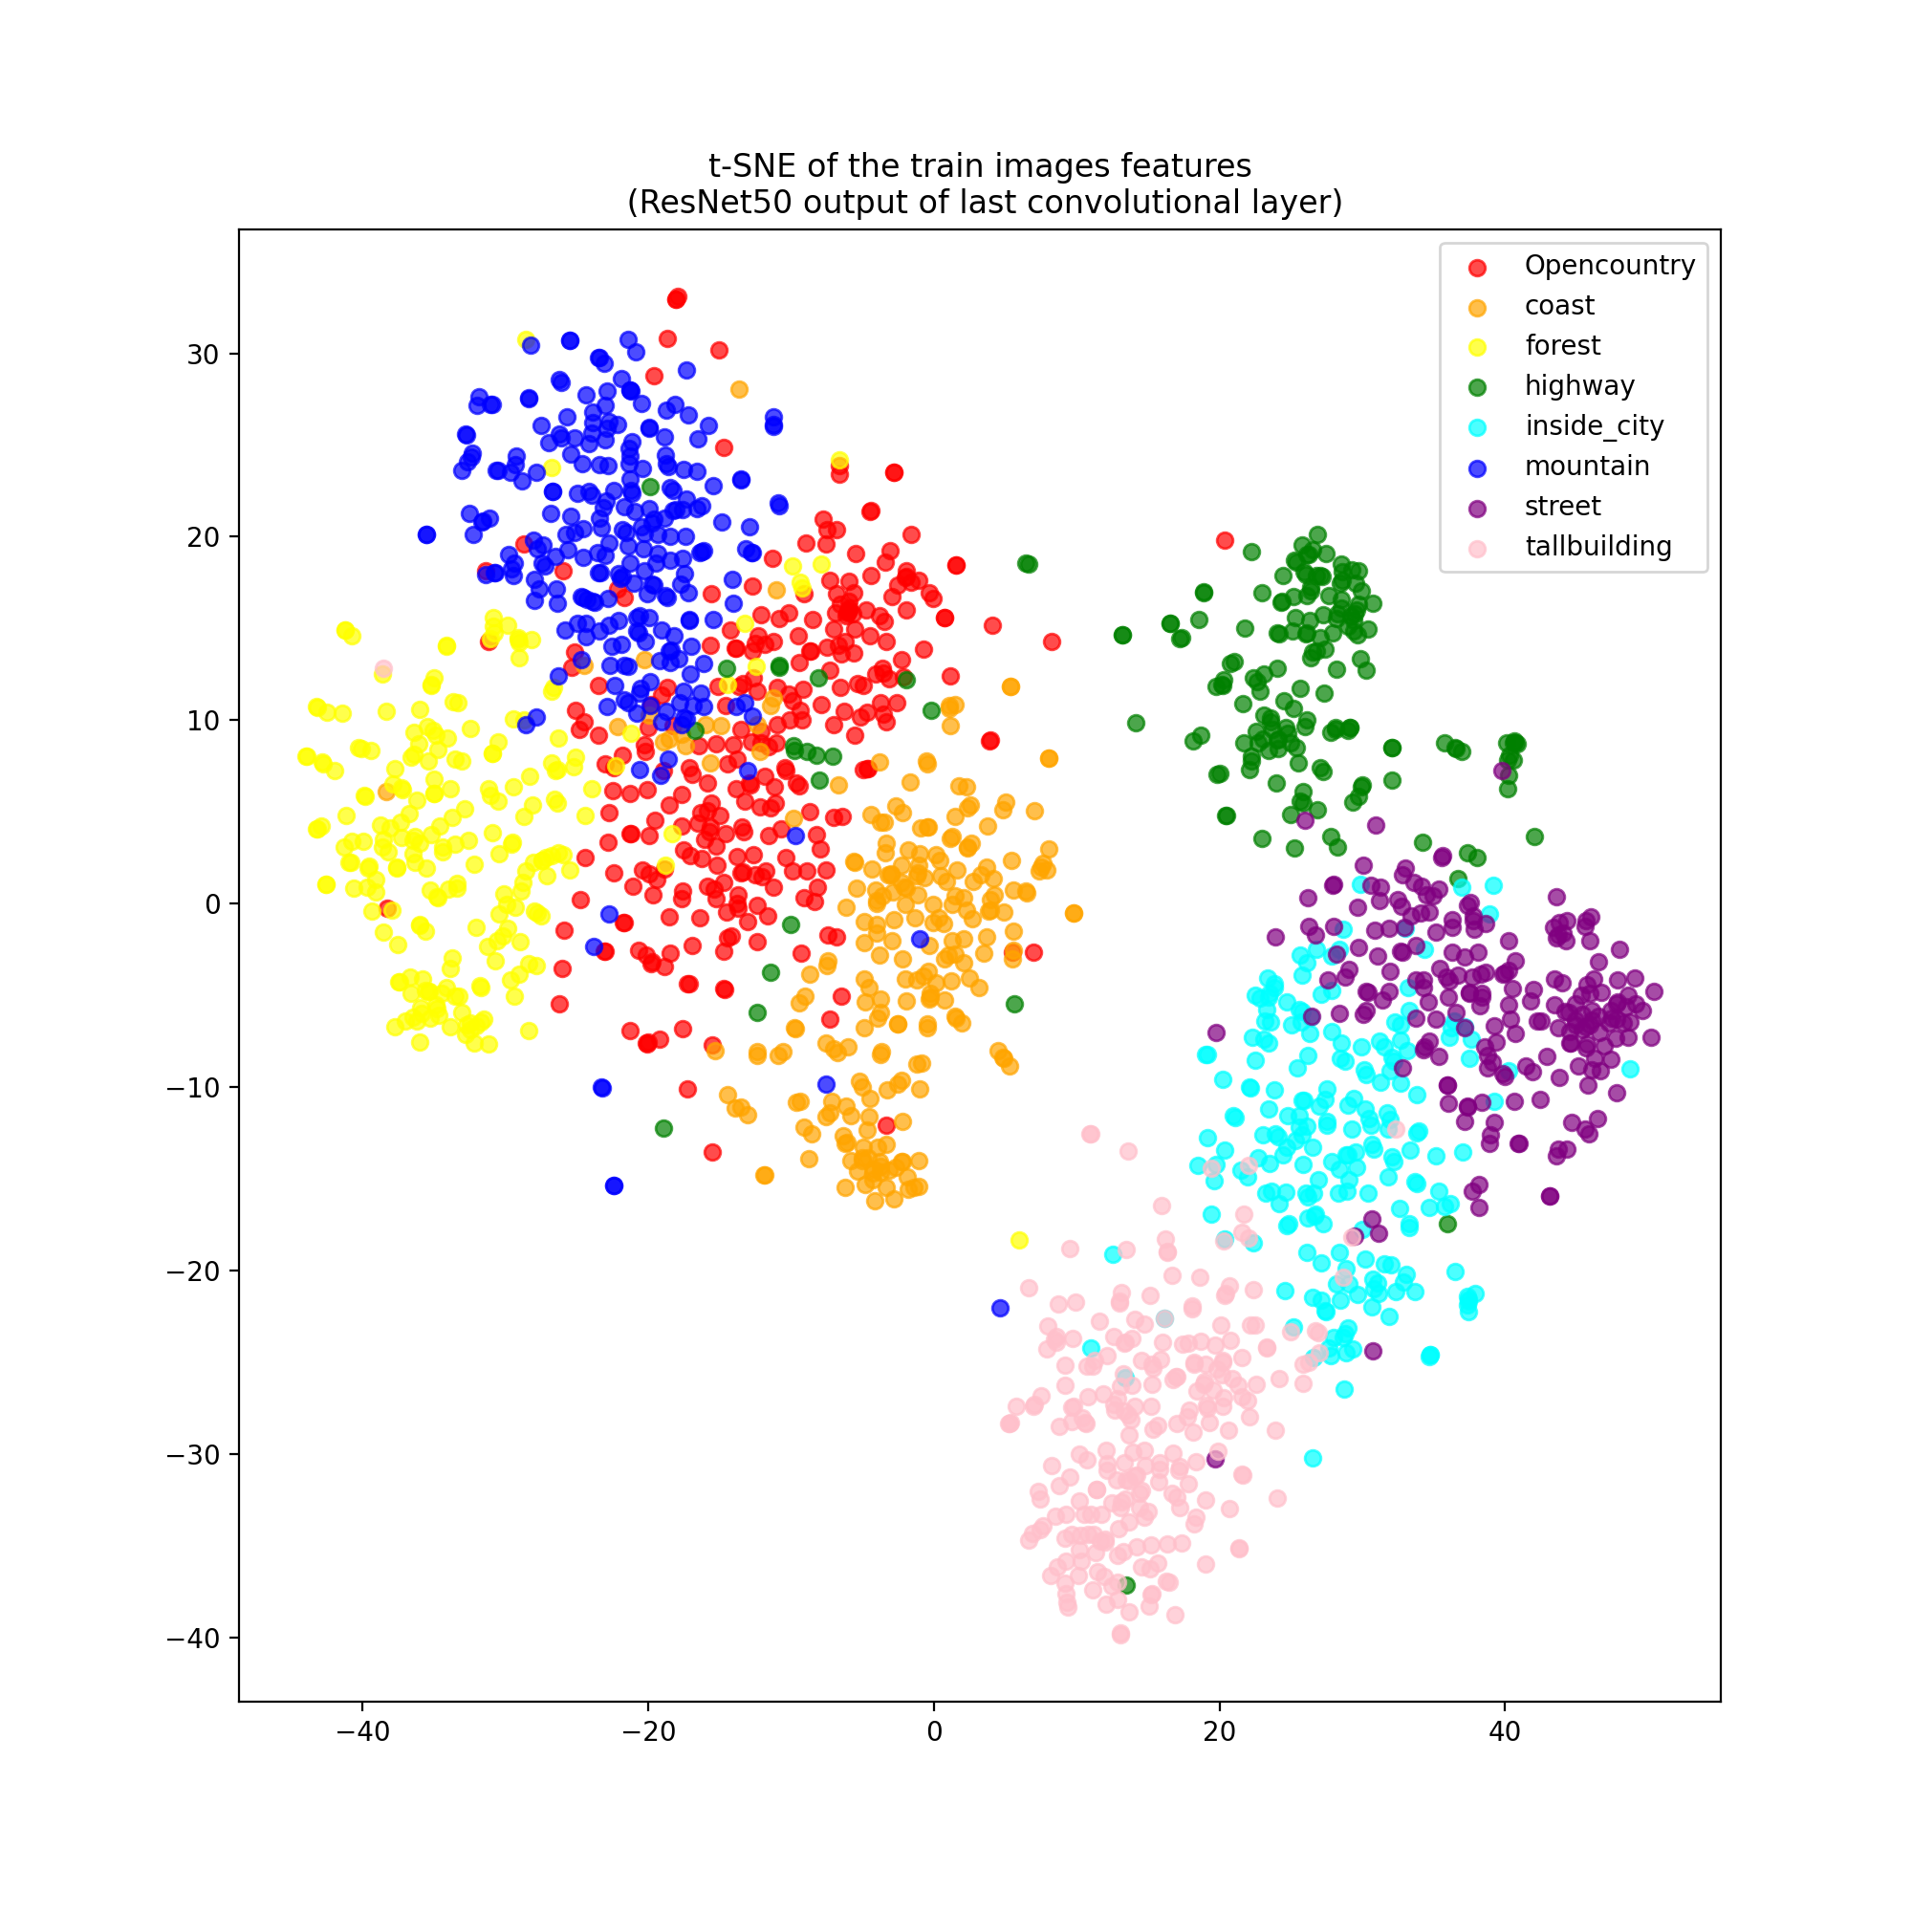
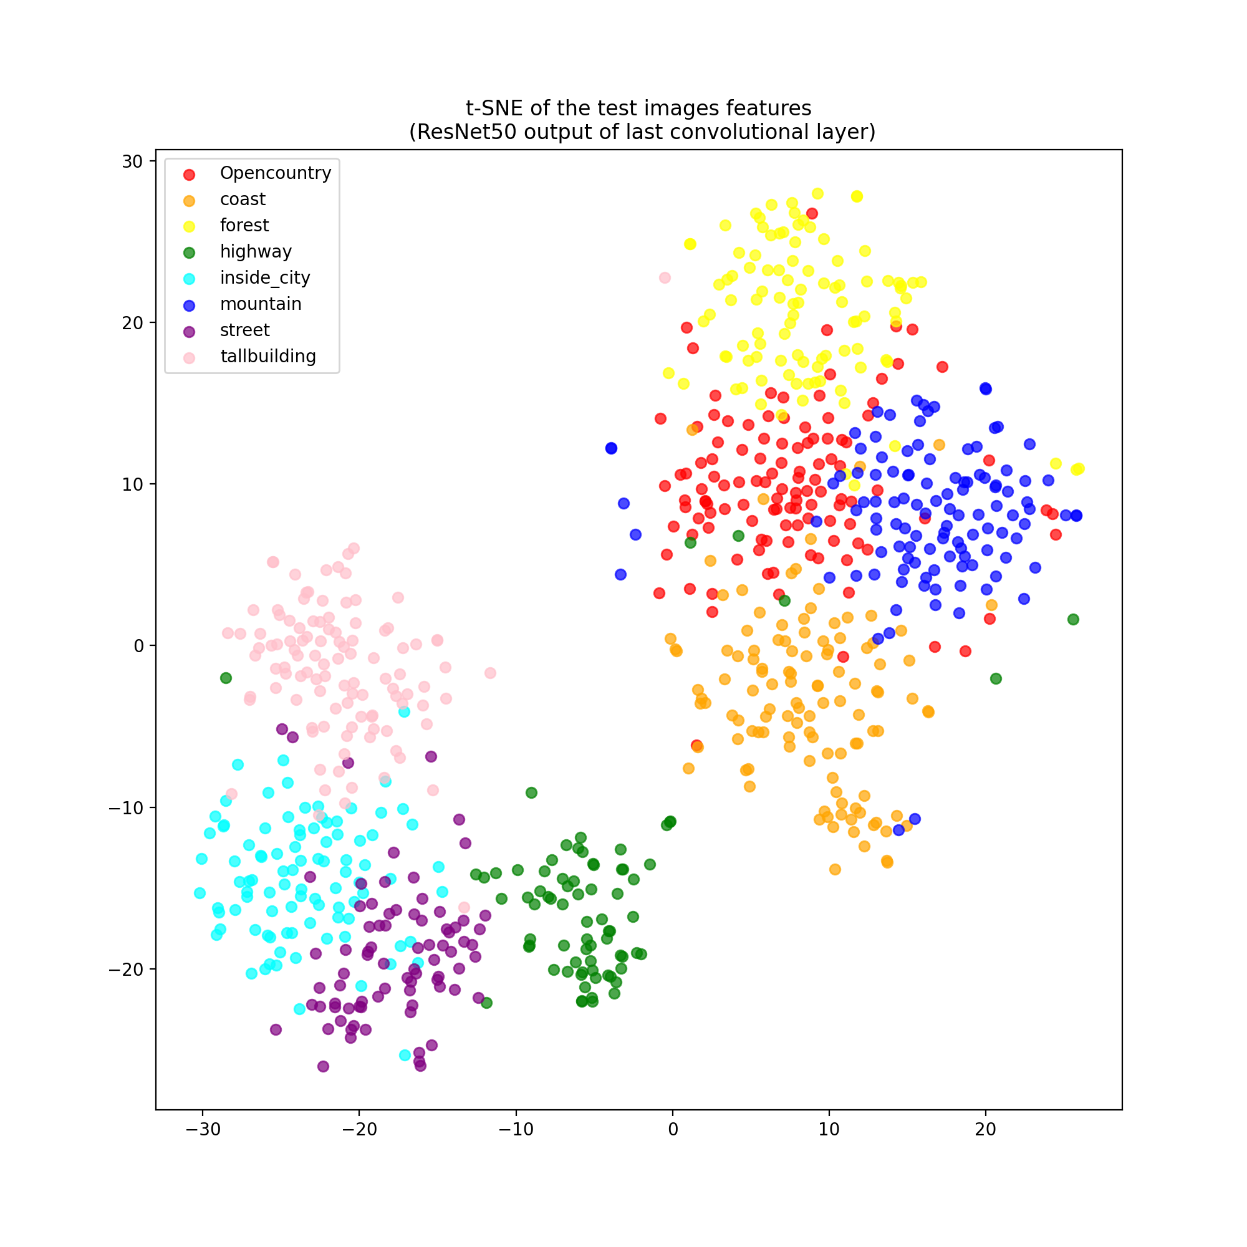
Task (a): Image retrieval with pre-trained image classification model
4. Remove last fully-connected layer of Resnet50 to output just the extracted features.
t-SNE visualization:
We can see that several classes like Opencontry, mountain and forest have similar features, even in the train subset. We will see later in the retrieved images plots that this may affect to the retrieval results for those classes.

Slide 7
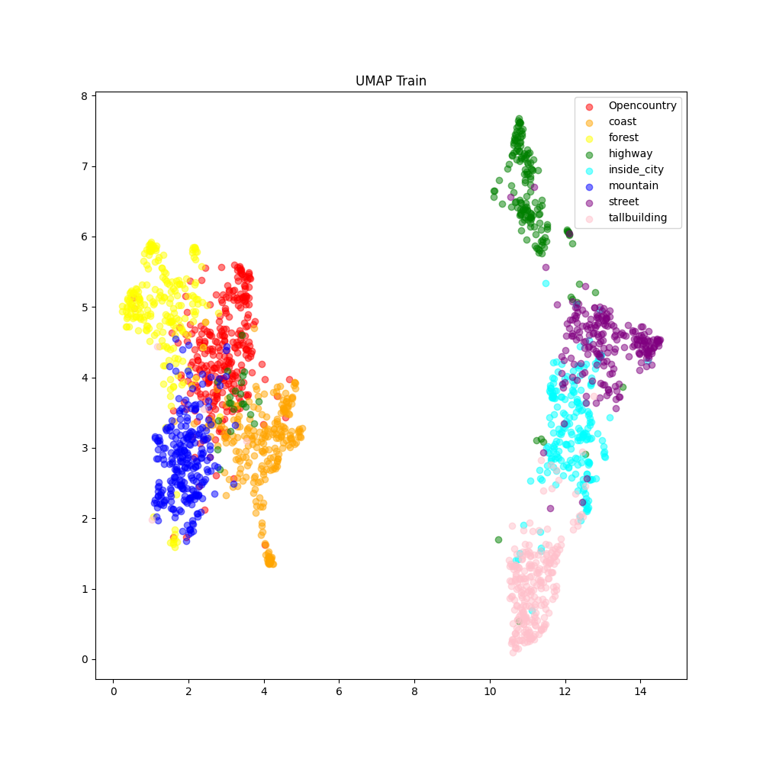
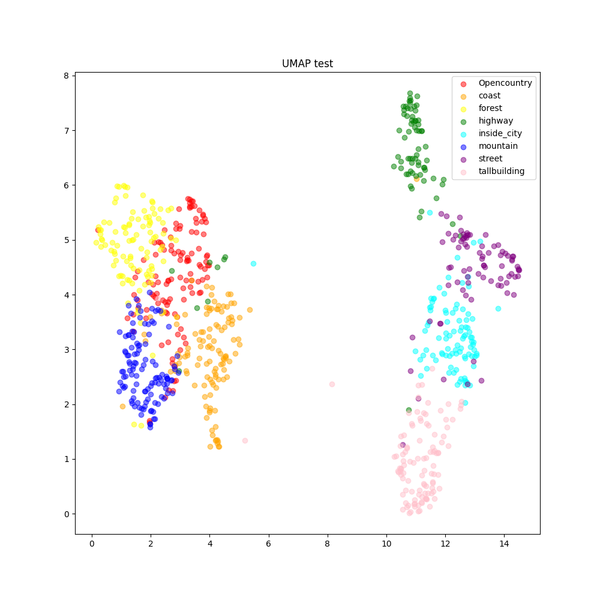
Task (a): Image retrieval with pre-trained image classification model
4. Remove last fully-connected layer of Resnet50 to output just the extracted features.
UMAP visualization:
Also in the UMAP visualization we can see that the classes of Opencontry, mountain and forest have similar features, even in the train subset. The visualization is very similar to the tSNE, with the exception of Highway class that with UMAP seems more separable than the rest of the classes. Moreover, it seems like with UMAP, there is more separation between the classes on the left and on the right of the image, which in fact makes sense, since the ones on the left are more related with nature and the ones on the right are more related to cities and may have similar features.

Slide 8
Task (a): Image retrieval with pre-trained image classification model
5. Use KNN to perform image retrieval based on the Resnet50 features of the images.
Quantitative results:
Metrics explanation:
Prec@k is a performance metric that measures the proportion of relevant images among the top k retrieved images.
AP summarizes a precision-recall curve as the weighted mean of precisions achieved at each threshold, with the increase in recall from the previous threshold used as the weight. We used the similarity scores between the query image and its k-nearest neighbors.
Metrics analysis:
mAP@5 is very high because the first 5 images have a very low distance to the query image, since the features describe very good the images, with a good generalization capability.
For the same reason, even the Prec@1 is very high, because an 84% of the time the first retrieved image is correct.
Metric | Value for test subset
mAP@5 | 0.8673
mAP@all | 0.4564
Prec@1 | 0.8439
Prec@3 | 0.8029
Prec@5 | 0.7846
Prec@10 | 0.7621
Prec@20 | 0.7290
Prec@30 | 0.7050

Slide 9
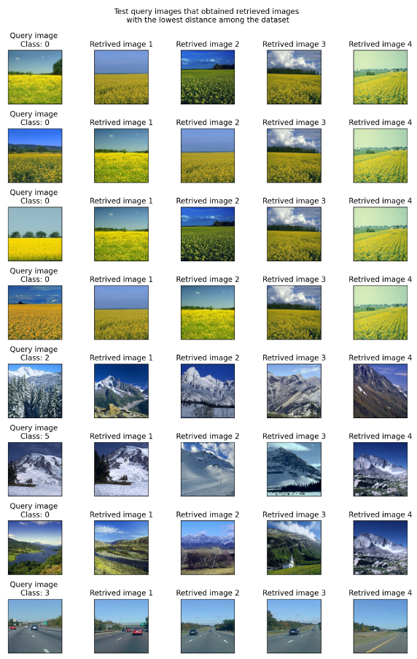
Task (a): Image retrieval with pre-trained image classification model
5. Use KNN to perform image retrieval based on the Resnet50 features of the images.
Qualitative results (BEST results):
We can see in the figure at the right, that the query images with lowest distance to the retrieved images are the ones of the class 0 (opencountry), and that in most cases all the 5 first retrieved images of that queries are of that class, hence getting the high Prec@5 we saw in the previous slide.
The same happens with the classes 2 and 3 (forest and highway respectively) that most of the time the retrieved images are of the same class. Specially for the case of the highways, that are very similar between them, having almost not differences in features between the highway images of test and train subsets.
However, notice that, even in the best cases as shown in right, sometimes the retrieved image, despite having a very low distance to the query image, can be of class 5 (mountain) when the query image is of class 2 (forest) due to the trees that usually appear in some mountains.

Slide 10
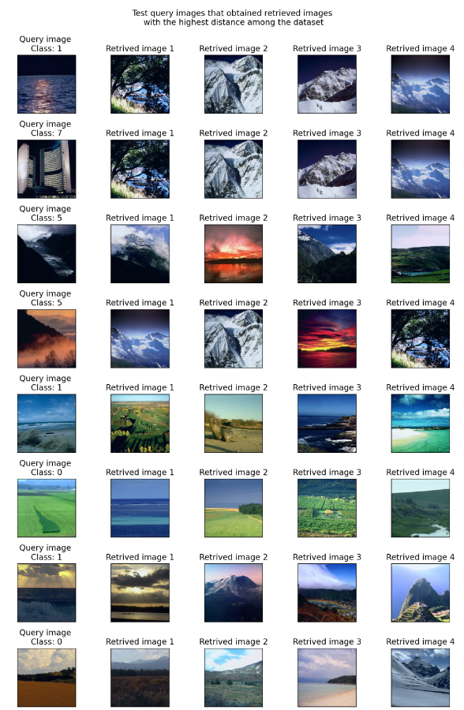
Task (a): Image retrieval with pre-trained image classification model
5. Use KNN to perform image retrieval based on the Resnet50 features of the images.
Qualitative results (WORST results):
We can see in the figure at the right, that the query images with highest distance to the retrieved images are the ones of the class 5 (mountain), that when are very dark, the extracted features are not so meaningful and are confused with so other classes.
Very unusually, the class 1 (coast) is confused with the class 0 (opencountry) as we can see in the second row, fifth column. This happens among the top-5 retrieved images, reducing the Prec@5, but not the Prec@1 since as we saw in previous slide quantitatively, 84% of the times, the first retrieved image coincides in the class with the query image.
It can be noticed that the last 2 rows, that are the 5th and 6th worst retrievals, are extremely good, being the 5th perfect for the first 5 retrieved images, and the 6th only failing in the 5th row (4th retrieved image) that confuses a class 6 (street) with class 4 (inside city) that are extremely similar visually. Specifically, check 4th and 5th columns of last rows and check how similar are those 2 retrieved images despite being of those 2 different classes.
As a conclusion, the retrieval system only fails in cases in which a human would also fail.

Slide 11
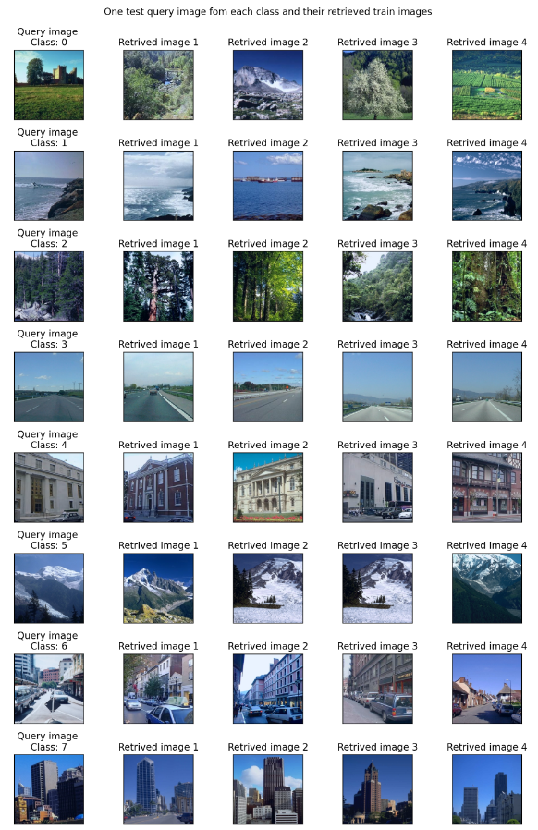
Task (a): Image retrieval with pre-trained image classification model
5. Use KNN to perform image retrieval based on the Resnet50 features of the images.
Qualitative results (For each CLASS):
We can see in the figure on the right, a query image for each of the 8 classes and
the closest retrieved images.
For all the cases shown we see that the retrieved images are from the same class and also look quite similar except for the open country (class 0).

Slide 12
Task b: Train the model on metric learning (Siamese network)

Slide 13
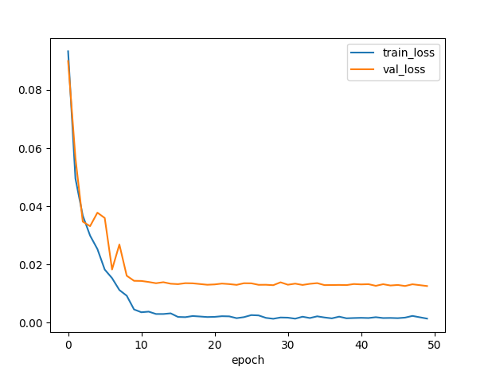
Task b:Train the model on metric learning (Siamese network)
We trained a Siamese network with pre-trained ResNet-50 to perform the image retrieval.
We used the triplet margin loss.
We see that training and validation losses are quite stable and they converge with very few epochs. We can say that the Siamese network was trained correctly, without overfitting.
Contrastive Loss

Slide 14
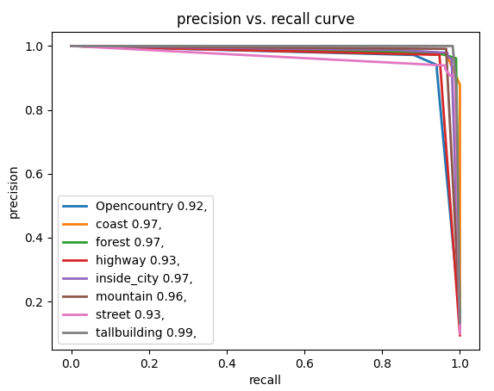
Task b:Train the model on metric learning (Siamese network)
To evaluate the results we plotted the Precision and recall curve. We see that in general , results are very high, indicating a good metric learning.
However, for open country, highway and street slightly lower results are achieved. This may be due to the fact that this classes are more similar and thus, more difficult to distinguish, as we have seen in previous weeks.
Quantitatively, we reach the following results:
Metric | Value for test subset
mAP | 0.973
Prec@1 | 0.960
Prec@5 | 0.963

Slide 15
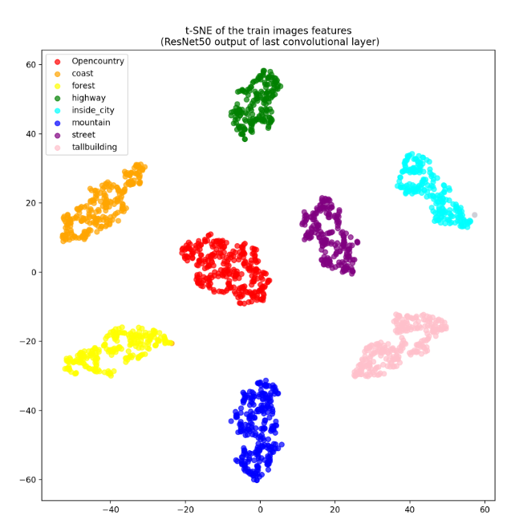
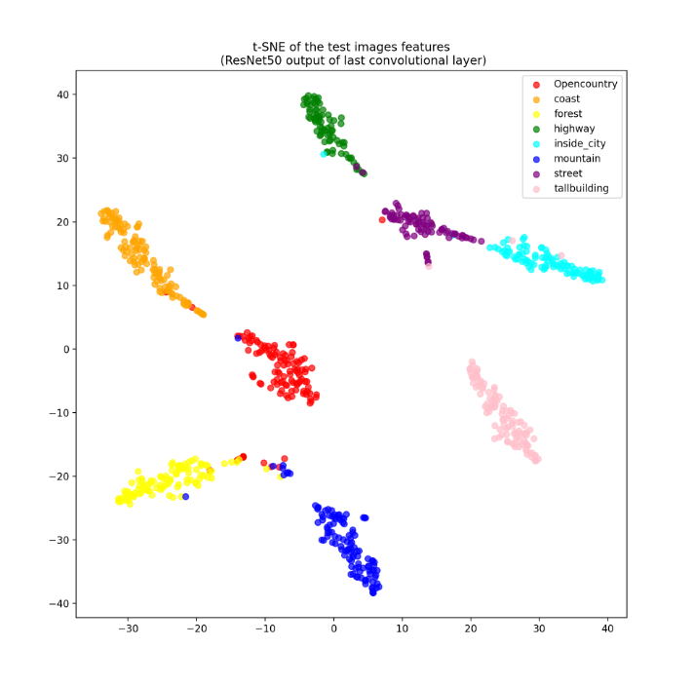
Task d) Visualize the learned image representation of task b
With the TSEN we see how during training, metric learning worked well. Note that the classes seem to be very well differentiated and there are almost no errors.
For the test, we see how opencountry is sometimes confused with forest or mountains. Also , inside city and streets are closer and seem to have some shared features.

Slide 16
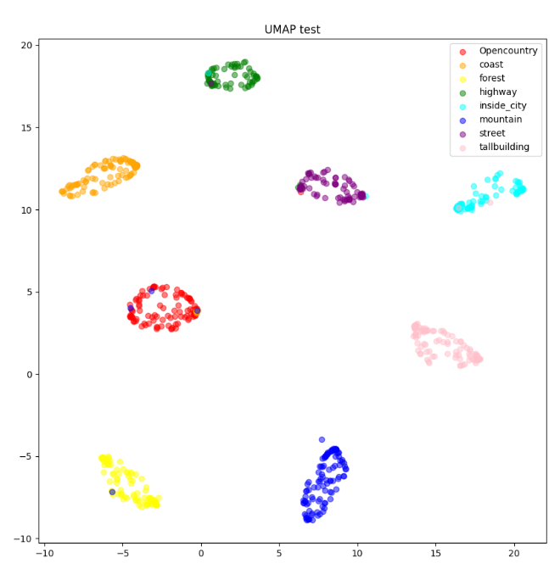
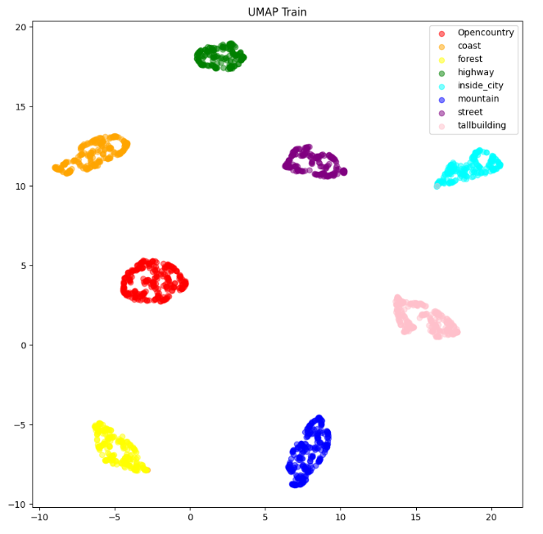
Task d) Visualize the learned image representation of task b
With the UMAP classes seem to be more separated.
However, the commented results also apply, as we see some mountain images closer to the cluster of open country.

Slide 17
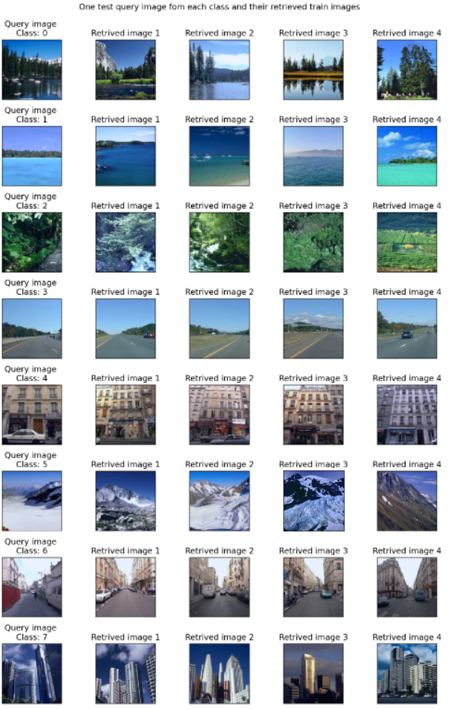
Task d) Visualize the learned image representation of task b
Here we see how all the retrieved images are from the correct class.
We see that the retrieved images are more similar to the query ones than the previous approach.

Slide 18
Task c: Train the model on metric learning (Triplet network)

Slide 19
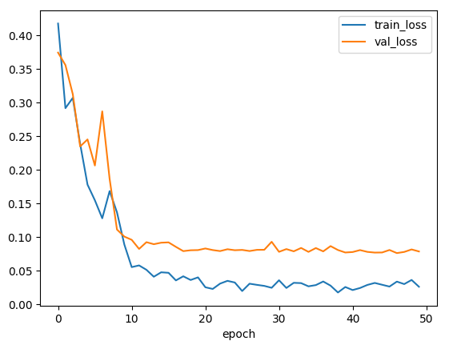
Task c:Train the model on metric learning (Triplet network)
We trained a Triplet network with pre-trained ResNet-50 to perform the image retrieval.
We used the triplet margin loss with
margin = 1.
We see that training and validation losses are more unstable than in the Siamese case. However, they converge with very few epochs. We can say that the Triplet network was trained correctly, without overfitting.
Triplet Loss

Slide 20
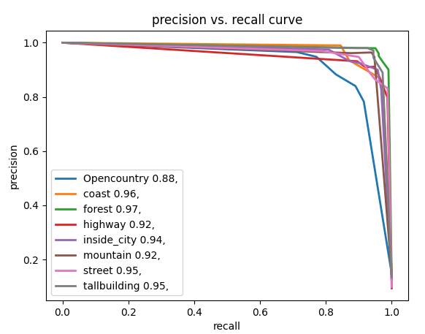
Task c:Train the model on metric learning (Triplet network)
To evaluate the results we plotted the Precision and recall curve. We see that in general , results are very high, indicating a good metric learning. However, they are a little bit lower than with the Siamese network.
In this case, Open country’s mAP is quite low compared to the other classes.
Quantitatively, we reach the following results:
Metric | Value for test subset
mAP | 0.931
Prec@1 | 0.913
Prec@5 | 0.915

Slide 21
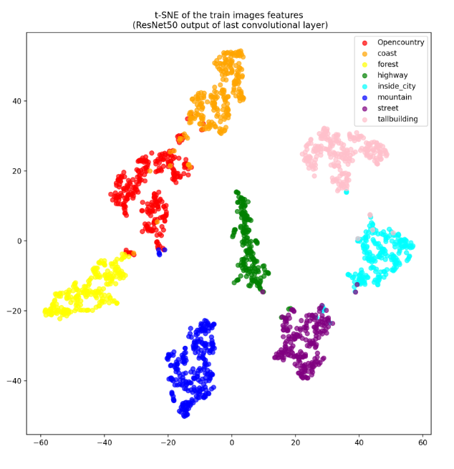
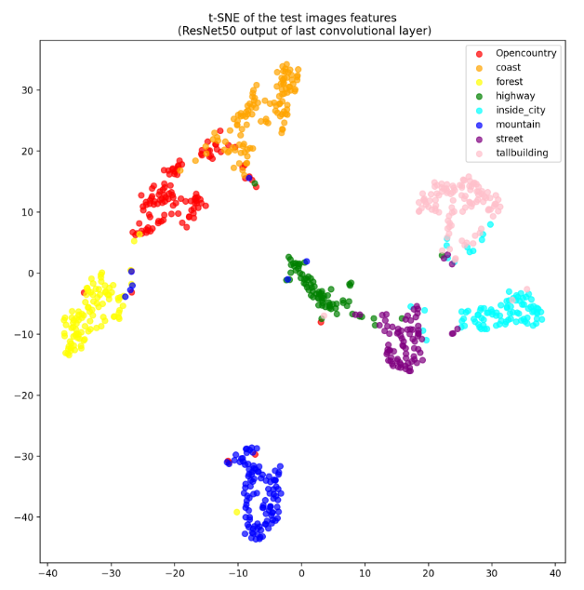
Task c:Train the model on metric learning (Triplet network)
With the TSEN we see how during training, metric learning worked well. Note that the classes seem to be very well differentiated although there are some features from mountain that are close to the open country.
For the test, we see how the features are not that well separated. The clusters are more close and there are multiple points too close to the wrong cluster. Note also that open country and coast seem to be mixed.

Slide 22
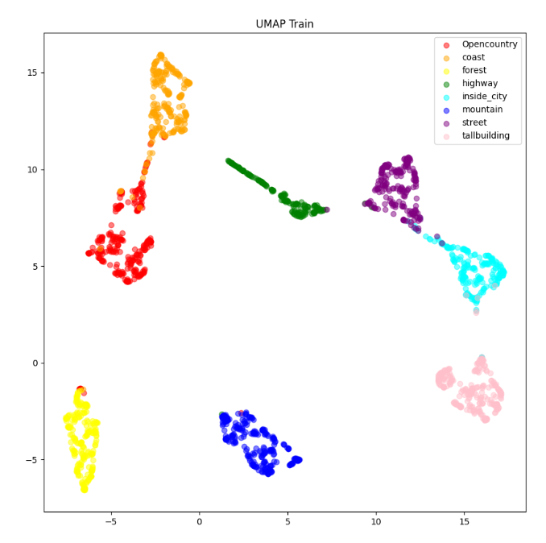
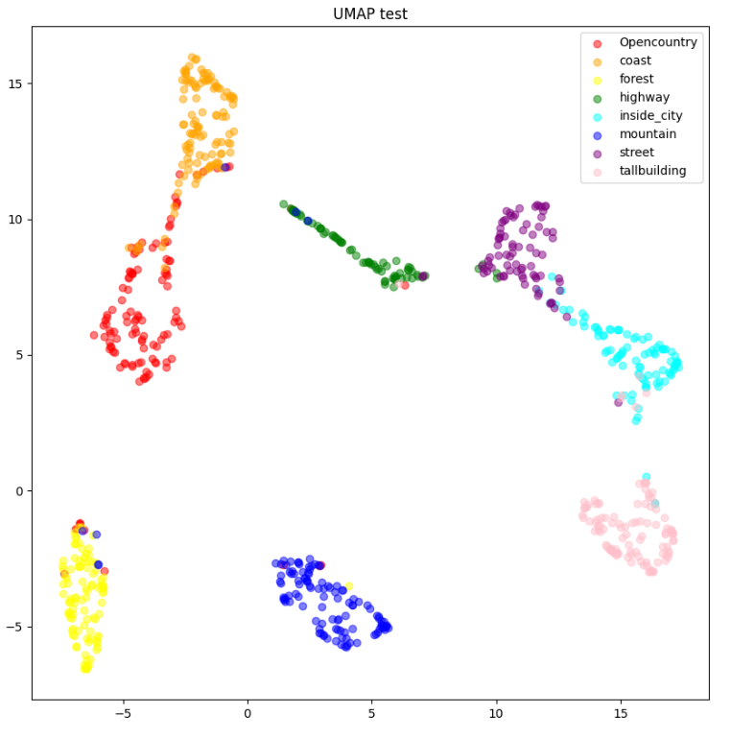
Task c:Train the model on metric learning (Triplet network)
With the TSEN we also see how open country and coast features seem to be similar. Something similar happens with the street and inside city classes.
Moreover, in the test we note that there are some confusions with the features classification.

Slide 23
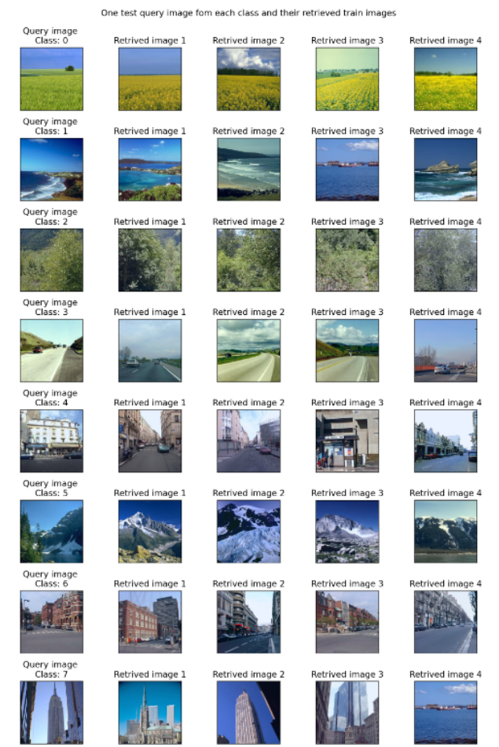
Task c:Train the model on metric learning (Triplet network)
Here we see how in general, the retrieved images are similar to the query images. In this case, the most clearer error is the retrieved image 4, for the tall building query. Note also that there are some confusions with the street class (class 6) and the inside city (class 4).

Slide 24
Task d: Visualize the learned image representation of each of the previous tasks a-c.

Slide 25
Task (d) Visualize the learned image representation of each of the previous tasks a-c → TSNE
with pre-trained image
classification model
with Siamese network
with Triplet network
Both, Siamese and triplet networks seem to perform better to learn representative features from each of the classes. We see that the clusters are more differentiated than in the first approach. Moreover, the siamese network seems to perform a little bit better than the Triplet.

Slide 26
Task (d) Visualize the learned image representation of each of the previous tasks a-c → UMAP
with pre-trained image
classification model
with Siamese network
with Triplet network
For the first approach, it seems like there are two differentiated main clusters nature and urban pictures.
Both, Siamese and triplet networks seem to perform better to learn representative features from each of the classes than the first approach. However, in this case it seems like the siamese is able to differentiate better all the classes, since the triplet has the open country and coast classes really close, and the street and inside city too.

Slide 27
Task (d) Visualize the learned image representation of each of the previous tasks a-c
Visualization findings:
Visualizations aid in understanding higher-dimensional spaces.
Similar classes cluster closer together, revealing distinct patterns.
Two main clusters identified: nature and urban pictures, specially for the first approach (Resnet 50).
t-SNE and UMAP are effective visualization techniques.
t-SNE preserves pairwise distances, while UMAP maintains neighborhood relationships.
UMAP tends to produce representations where train and test data appear more similar compared to t-SNE (as we saw in the graphs shown in task a-c).
Multiple visualization techniques enhance comprehensive understanding of data.

Slide 28
Task e: Image Retrieval on COCO with Faster R-CNN or Mask R-CNN

Slide 29
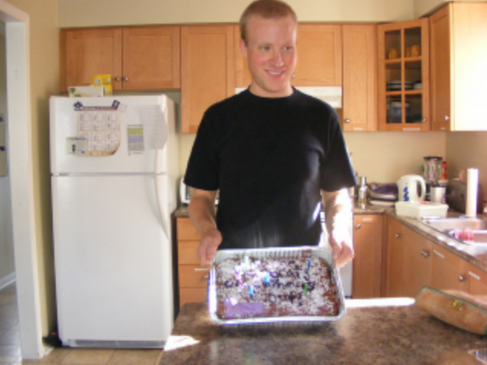
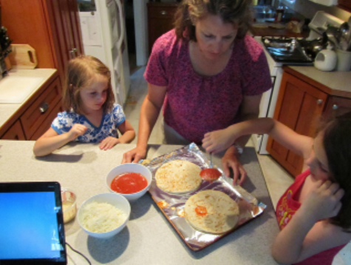
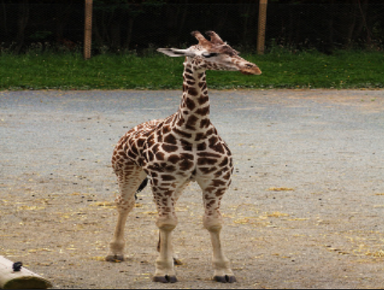
Task e: Goal
The objective of this task is to perform retrieval of coco images dataset 2014 using an object detection network as embedding network in order to compute the triplet loss.
To generate positive and negative image pairs for triplet loss training, we will follow these criteria:
A positive image contains at least one object of the same class as the anchor image.
A negative image does not contain any object of the same class as the anchor image.
Refrigerator
Anchor img
Positive img
Negative img

Slide 30
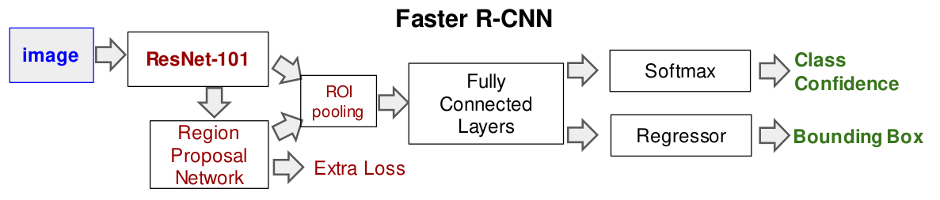
Task e: Method
We use the FasterRCNN with ResNet-50 as backbone pretrained with COCO dataset as embedding network.
Two hooks are registered to extract features of the bounding box and the score of these bounding boxes.
512 proposals per image are obtained, and each proposal has 1024 features and 91 scores.
The maximum value of the score for each proposal is used, and a softmax is performed along all scores of all proposals to translate them as weights.
A weighted average of these features is performed to obtain 1024 features per image.
Two methods are considered to proceed:
Without FC: Returning these 1024 features as output of the model
With FC: Using the same fully connected layer as the previous tasks to obtain an embedding of dimension 2 for each image.
Scores [Batch-size, 512, 91]
ResNet-50
Features [Batch-size, 512, 1024]

Slide 31
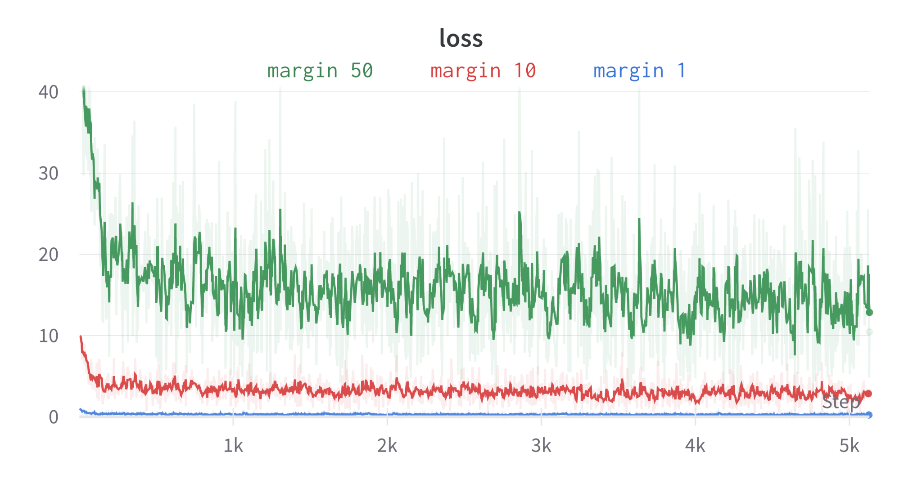
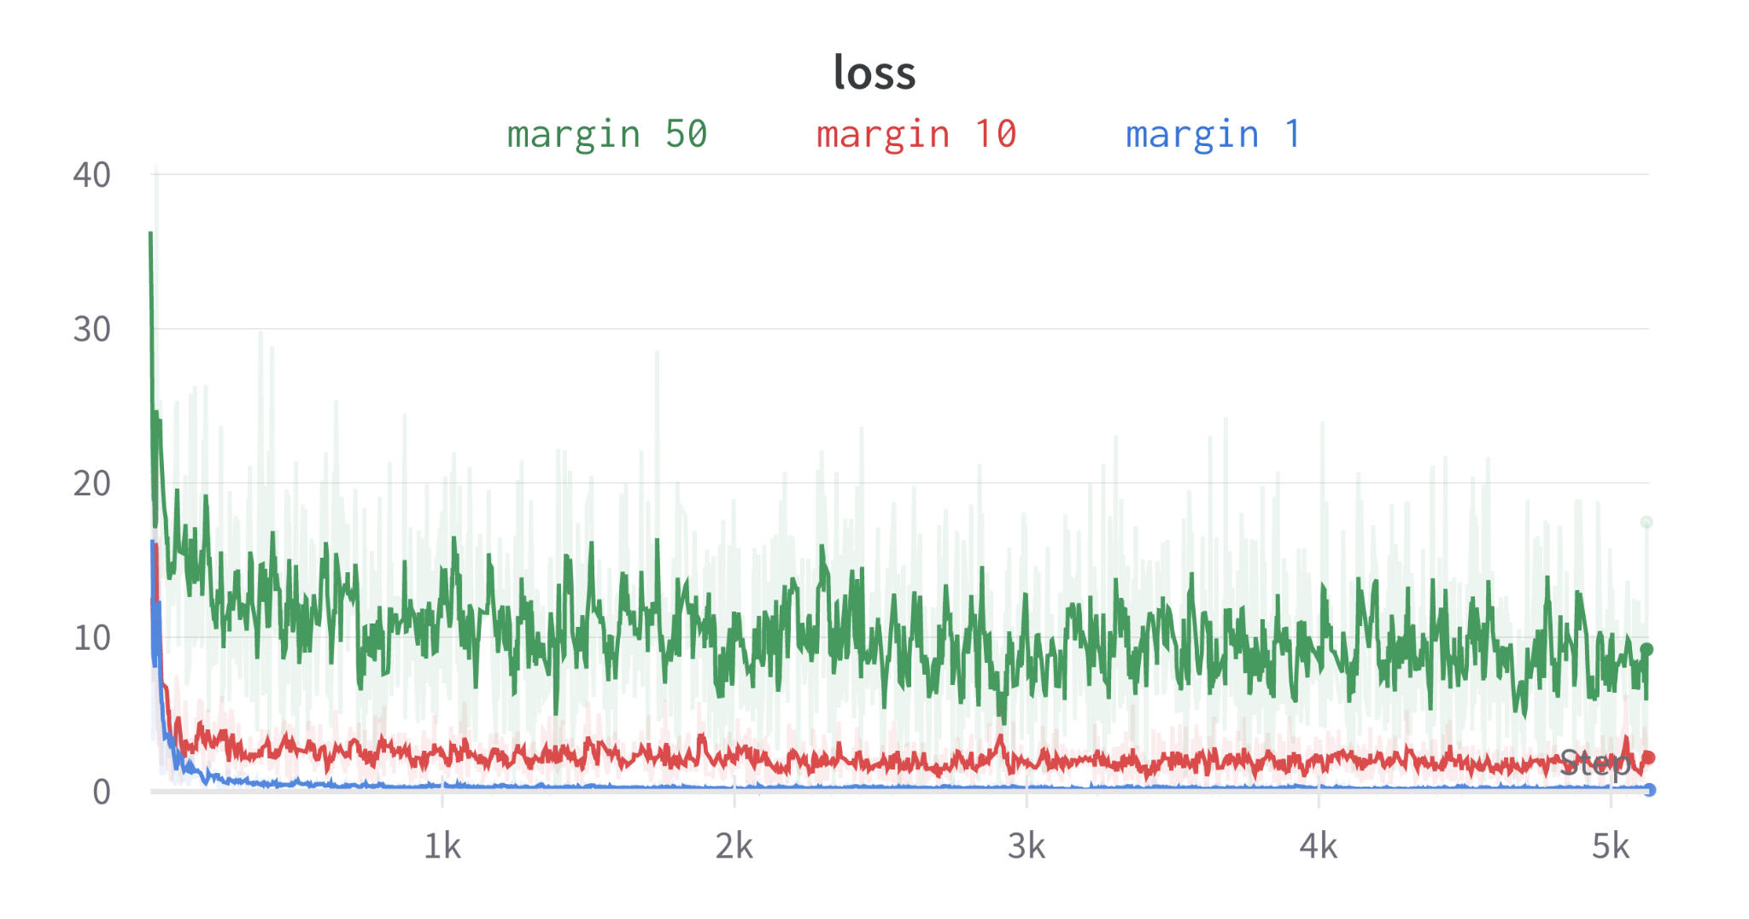
Task e: Fine-tuning
Fine-tuning is performed on the two networks explained in the previous slide, using a batch size of 16 and a learning rate of 1e-5.
Different values of margin are experimented with ( 50, 10, 1)
Only two epochs are used due to the amount of time required (3h using RTX 3090).
The loss function for all cases shows that all models are able to learn fast, but the loss remains unstable.
The method without the fc layer obtains smaller loss values.
With FC
Without FC

Slide 32
Task e: Evaluation
With FC
Without FC
Metric | Margin 1 | Margin 10 | Margin 50
mAP | 0.810 | 0.809 | 0.792
Prec@1 | 0.759 | 0.756 | 0.738
Prec@5 | 0.753 | 0.743 | 0.736
Metric | Margin 1 | Margin 10 | Margin 50
mAP | 0.944 | 0.948 | 0.949
Prec@1 | 0.916 | 0.937 | 0.933
Prec@5 | 0.925 | 0.928 | 0.929
Much better performance using the network without FC. One possible reason for this is that the FC layer might be compressing the features too much, leading to a loss of information. This can make it harder for the model to distinguish between similar images, resulting in higher loss values.
When the 1024 features per image are used directly as output of the model, the model has access to more information and can better distinguish between similar images, leading to smaller loss values

Slide 33
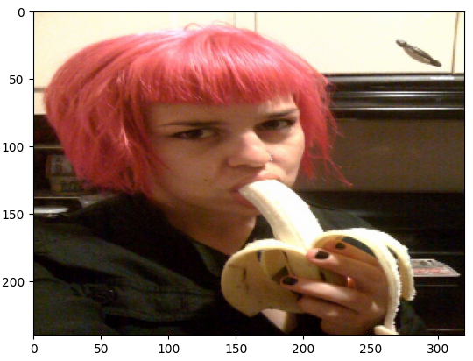
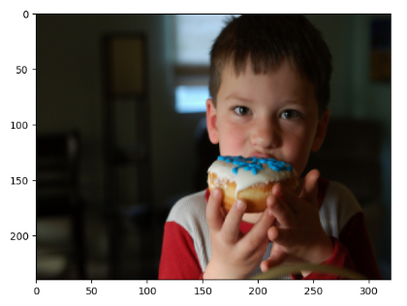
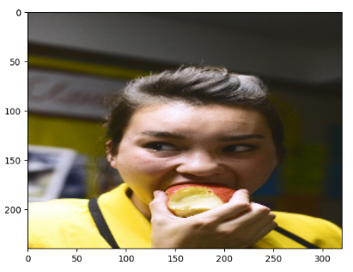
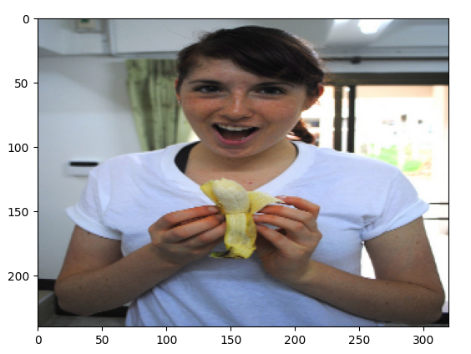
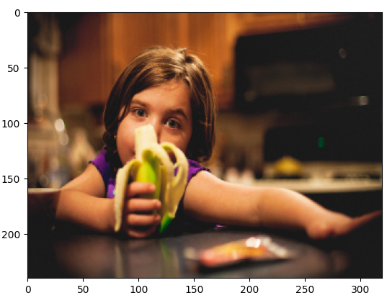
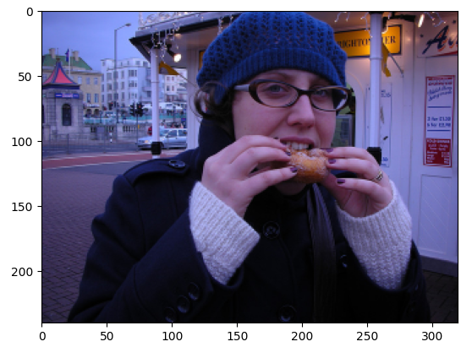
Task e: Retrieval: Good Example
Query Retrieved 1 Retrieved 2 Retrieved 3
Without FC
With FC

Slide 34
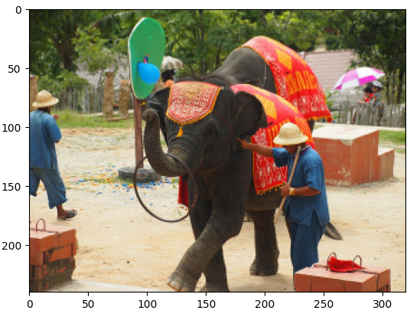
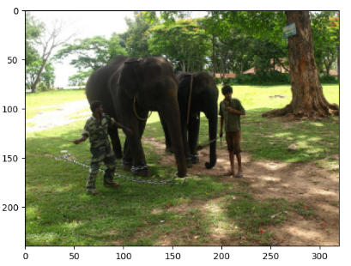
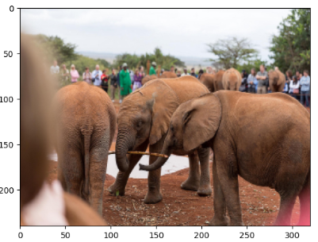
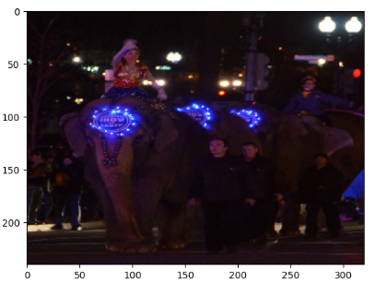
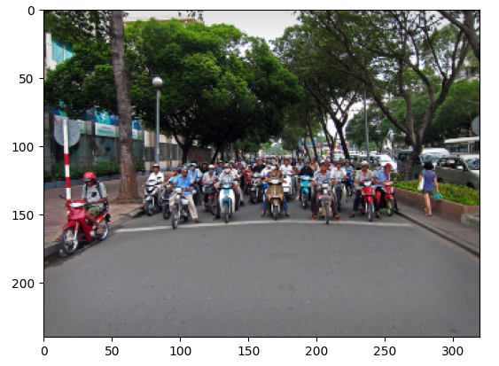
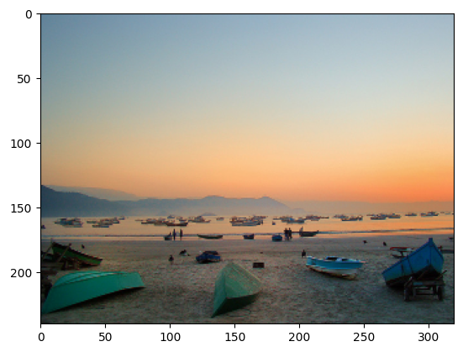
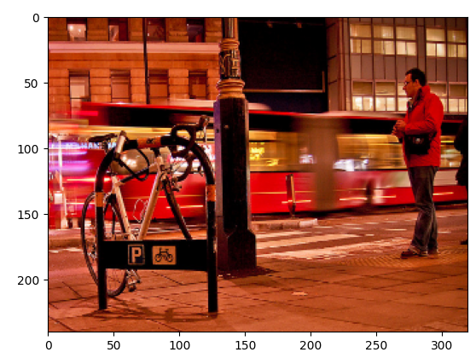
Task e: Retrieval: Good / Bad example
Query Retrieved 1 Retrieved 2 Retrieved 3
Without FC
With FC

Slide 35

Task e: Discussion
On slide 33, the retrieved images appear similar to the query image using both methods.
However, on the following slide, it becomes evident that the FasterRCNN network is already proficient in capturing relevant object retrieval information, and projecting the embeddings into 2 dimensions is not necessary.
The "with FC" method appears to be ineffective for certain query images.
The current metrics are not particularly stringent, as they only consider retrieved images with at least one common object with the query image as correct.
Therefore, further analysis is required using additional metrics, such as weighted aggregation, to determine if the retrieved image contains similar objects with similar quantities as the queried image.

Slide 36
Conclusions

Slide 37
Conclusions
Metric | Resnet-50 | Siamese | Triplet
P@1 | 0.844 | 0.96 | 0.913
P@5 | 0.785 | 0.963 | 0.915
mAP | 0.867 | 0.973 | 0.931
Image retrieval with Resnet-50 resulted in worse results than when using the Siamese or Triplet networks.
Triplet networks are harder to train and in our case it performed slightly worse than Siamese.
TSME and UMAP are powerful tools to understand metric learning and imagine better the distribution of the classes.
Faster-RCNN with ResNet-50 as the backbone is employed for image retrieval on the COCO 2014 dataset by generating embeddings using object detection networks. While the method without the FC layer exhibits lower loss values, visual inspection of the retrieved images shows room for improvement. Therefore, more rigorous metrics and alternative approaches should be explored to enhance retrieval performance.
Better Results without FC in Faster-RCNN.
with Siamese network
Metric | COCODataset
mAP | 0.949
Prec@1 | 0.933
Prec@5 | 0.929
Notes:
Task a:
Object detection models such as FasterRCNN and MaskRCNN can struggle with object recognition when textures are similar or when objects are outside their context. FasterRCNN can misclassify objects with similar textures, while MaskRCNN can more accurately detect such objects. However, both models can still correctly detect and label objects outside their context in most cases.
Task b:
When transplanting objects into new images using MaskRCNN, the model is generally able to recognize the transplanted objects, especially for cases such as dogs and clocks. However, in some cases, such as TVs in dark backgrounds, the model may fail to detect the objects. This highlights the importance of background and lighting conditions for object detection.
Task c:
The background of an image plays a critical role in object detection accuracy, and overlapping or partially occluded objects can be challenging for the model. Duplicating objects in an image can provide additional information that can help the model detect and classify objects more accurately, especially if the duplicated object is in a different location or under different lighting conditions than the original object.
Task d:
Feature interference can be harmful to the detection process in MaskRCNN, as features obtained from pixels outside the region of interest can interfere with the predictions. Adding random noise can further amplify this issue. Therefore, it is essential to pay attention to the pixels and features included in the model's training and detection processes.
Task e:
Style transfer can impact object detectability, as some styles may result in texture loss and non-uniform contours, making it more difficult for object detection models to identify objects. It is important to choose styles that preserve object details and contours to minimize the impact on object detection accuracy.

